Slide 1
A Field Day:
Some Physics You May Find Useful
Olaf Hauk
olaf.hauk@mrc-cbu.cam.ac.uk
Introduction to Neuroimaging Methods, 1.4.2019

Slide 2
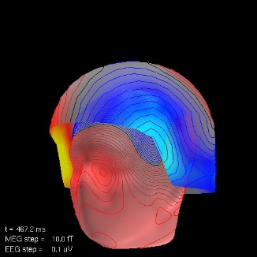
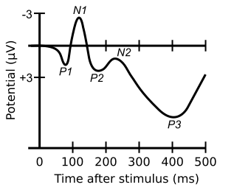
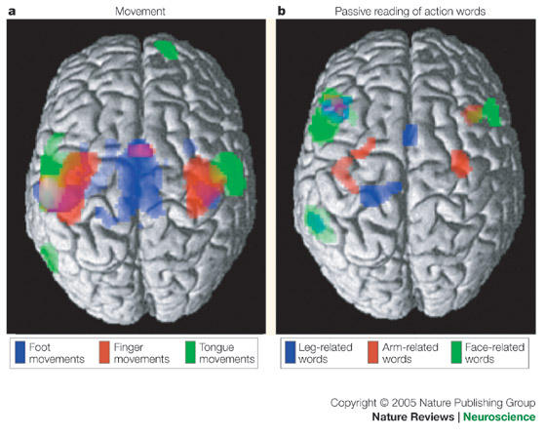
Challenges of Interdisciplinary Research
We are interested in cognitive/brain functions –
based on evidence from physical measurements:
Keep track of the inferential chain from measurement to conclusion.
VEPs
http://en.wikipedia.org/wiki/Visual_N1
SSVEP
Vialatte et al., Progr Neurobiol 2010

Slide 3
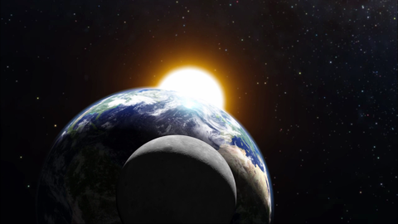
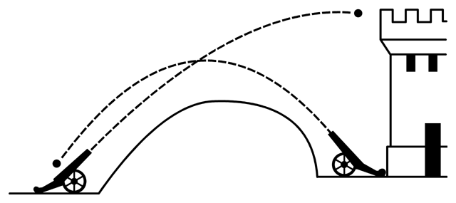
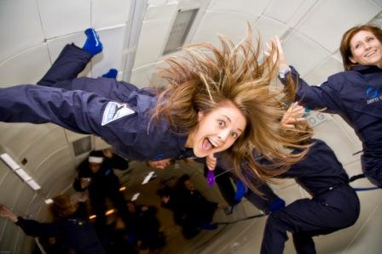
Newton’s Laws of Motion
A good example for linking theory and measurement
http://creativecan.com/2012/04/macbook-stickers/
An object only changes its velocity in reaction to an external force
F = m*a: The net force acting on an object is proportional to its mass and its acceleration (=> a = F/m)
If one body exerts a force on a second body, the second body exerts a force of the same magnitude on the first body (“actio et reactio”)
N.B.: We use the term “Weight” wrong. It should refer to the force on mass under gravitation, i.e. be measured in Newtons (e.g. our weight is different on the moon, but mass is not).

Slide 4
The (Gravitational) Potential
Potential Energy
A potential is only defined between two states/locations.
“Gravitational Potential”:
Energy required to move an object of unit mass to a reference location.
For example:
“How much energy can I gain by dropping my shoe from the roof?”
only makes sense if I specify how far it can fall – to the balcony? To the ground? To sea level? To the middle of earth?
Reciprocity:
The energy you get from dropping it you will need to
lift it back to its original position.

Slide 5
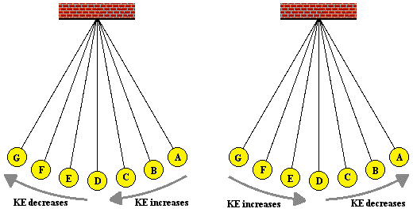
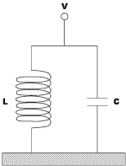
The Potential, Potential Energy
The Pendulum:
Conversion of potential energy into kinetic energy and vice versa
http://www.physicsclassroom.com/class/waves/u10l0c.cfm
Electric oscillator:
Conversion of voltage into current and vice versa

Slide 7
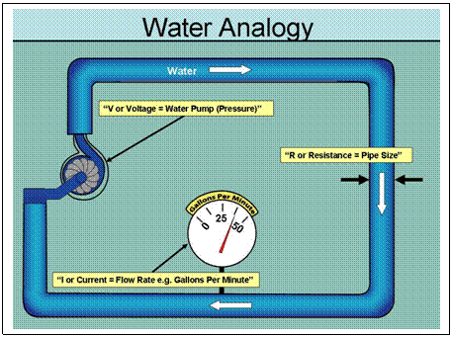
Electricity: Voltage and Current
Voltage:
Difference in electric potential between two points
or
Energy required to move an electric unit charge between two points
(1V = 1 “Joule per Coulomb” = 1 J/C)
Hydraulic Analogy:
Pressure ~ Voltage, Flow ~ Current
Resistance ~ Size of tube
http://apps.americanbar.org/lpm/lpt/articles/tch05071.shtml

Slide 8
Electricity: Ohm’s Law
For a given voltage, the current depends on the resistance of the conductor:
I = U / R
(“Ohm’s Law”)
(I: current (Ampere), U: voltage (Volt), R: resistance (Ohm, “Ω”))
If you can measure the voltage and the current, you can get the resistance:
R = U / I
Sometimes it is more convenient to talk about “Conductance”:
G = 1 / R
(G: conductance (Siemens))
Resistance can depend on the frequency of voltage/current, and it may affect amplitude and phase of a time-varying current. More general:
“Impedance”
(complex number)

Slide 9
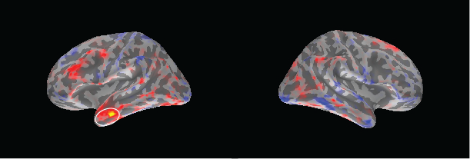
Current Flow in the Head
Conductances, currents etc. can vary with location (e.g. in different brain tissues)
They are often expressed as densities (per length, per area, per volume), e.g.
“resistance per unit length”
(Ohms per m etc.)
“current per unit area”
(A/m², pA/cm² etc.)

Slide 10
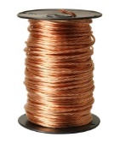
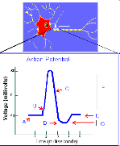
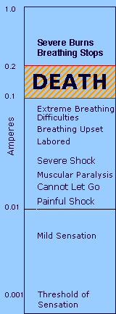
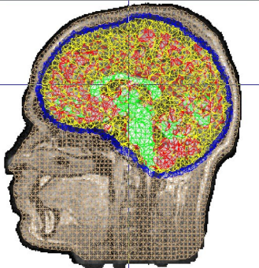
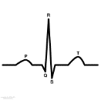
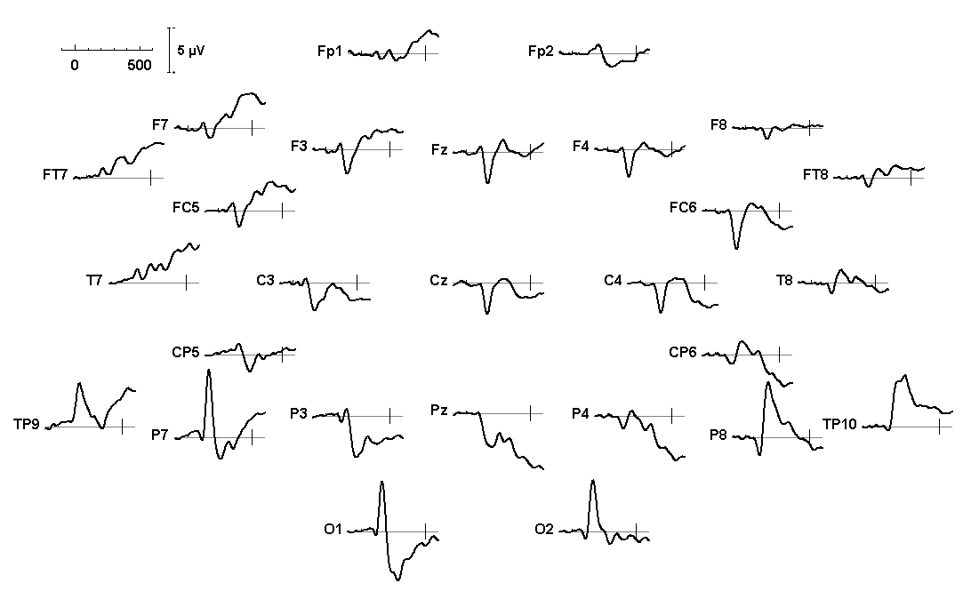
Examples of Voltages, Currents and Resistance
Household Batteries
~ 1-12 V
Copper (resistivity 17nΩ*m)
Wire (10m, 1 mm²)
~ 0.2 Ω ~ 5 S
Voltage 1V ->
Current 5A
(short circuit)
Membrane Potentials
~ 70 mV
Skull ~ 70 Ωm
Brain+scalp ~ 1 Ωm
ECG
~ 1mV
ERPs
~ 1-10 μV
http://www.sourcesignal.com/mrviewer.html
http://www.physics.ohio-state.edu/~p616/safety/fatal_current.html

Slide 11
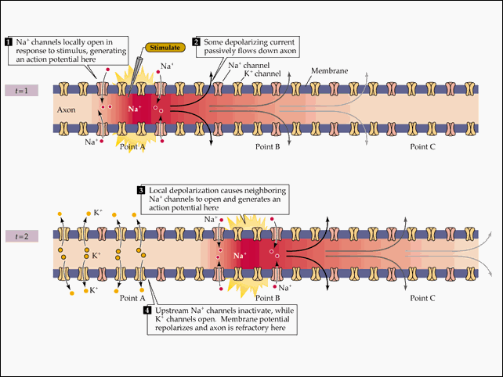
Nerves Are Not Wires
Action potentials are caused by active cellular mechanisms,
not passive “Ohmic” currents
http://www.arts.uwaterloo.ca/~bfleming/psych261/lec4se21.htm
Electric energy travels at ~ speed of light.
Electrons’ drift speed ~ centimetre per second (copper wire).
Action potentials ~ 10-50 meters per second.

Slide 13
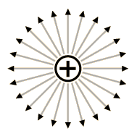
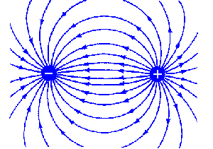
Electric Fields
Charges can act on each other without a conducting medium between them.
Electric field
Electric field lines: The path along which a positive charge would travel.
When a conductor is placed into an electric field, charges move along field lines.
Current density: J = σE (conductivity * electric field strength)
http://labman.phys.utk.edu/phys222core/modules/m1/Electric%20field.htm

Slide 14
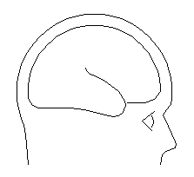
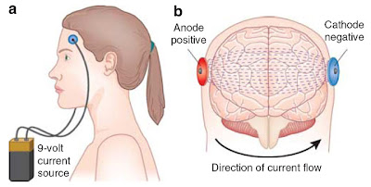
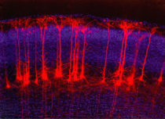
Example: Current Flow In The Head
EEG/MEG
“Volume Conduction”
tDCS
Transcracial direct current stimulation
“Volume”
Current
“Primary”
Current
http://neurocritic.blogspot.co.uk/2012/04/tdcs-symposium-stimulates-giant-brain.html

Slide 15
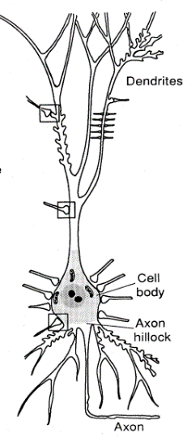
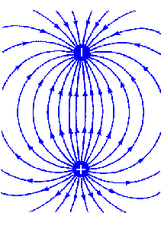
Coulomb’s Law
For a single charge: Electric field decreases with squared distance (in vacuum)
$E\left(r\right)=\frac{1}{4πε_{0}}$ $\frac{q}{r^{2}}$
For a “dipole”: Electric field decreases ~ with cubic distance (in vacuum)
http://en.wikipedia.org/wiki/Electric_dipole_moment
-
+

Slide 16
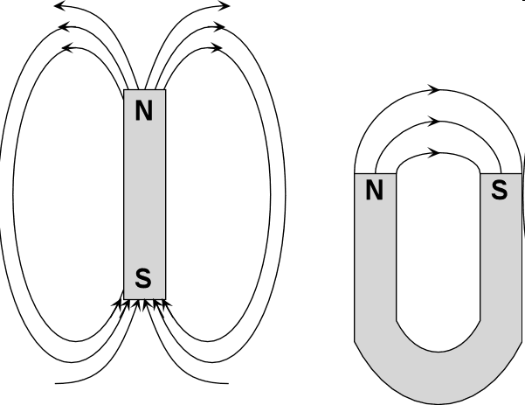
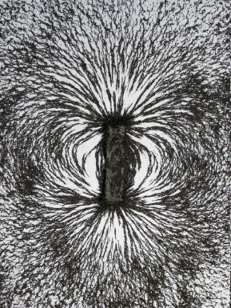
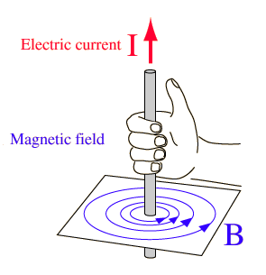
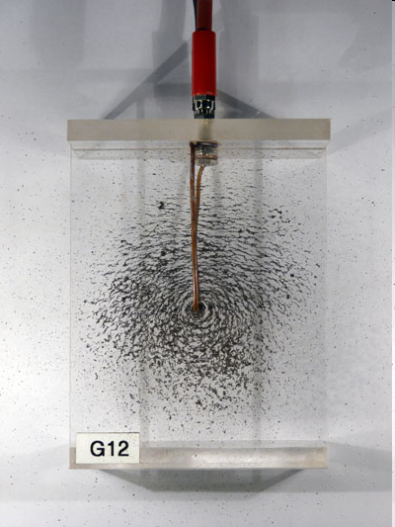
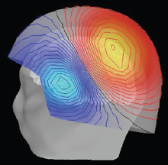
Magnetic Fields
Bar magnets
Right Hand Rule
Currents
There are no “magnetic monopoles”, field lines are always closed.

Slide 17
Magnetic Fields
The Biot-Savart Law describes the magnetic field due to a current (in vacuum):
$B\left(r\right)=\frac{μ_{0}}{4π}$ $\frac{dI × r}{r^{2}}$
The magnetic field strength decreases with squared distance to current.
The magnetic field direction is perpendicular to the current flow.

Slide 19
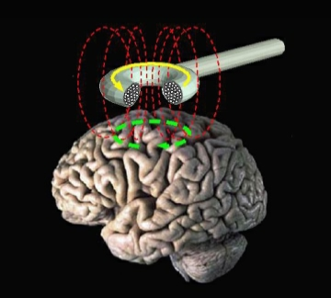
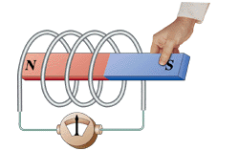
Magnetic Induction
Faraday’s Law of Induction:
The induced current in the coil is proportional to the rate of magnetic flux change inside the coil
TMS pulse duration ~ 100 μs, ~ 1T
Induced currents ~ mA

Slide 21
Eddy Currents
A changing magnetic field induces an electric current in a conductor
(“Eddy Current”).
Moving the conductor (e.g. body) can change the magnetic field around it.
The induced electric current may produce heat.
An electric current in a magnetic field receives a force.
Watch:
https://www.youtube.com/watch?v=mJoPwQpBU9w

Slide 23
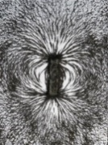
Maxwell’s Equations (Classical Electrodynamics)
They describe mathematically how electric and magnetic fields are generated and altered by each other and by electric charges and currents.
The summed electric flux around a close surface is proportional to the total electric charge enclosed within this surface (Gauss’s Law)
$$∇∙E=\frac{ρ}{ε_{0}}$$
Magnetic field lines are closed (Gauss’s Law for magnetism)
$∇∙B=$0
Changing magnetic fields produce an electric field proportional to the rate of change (Faraday’s Law of Induction)
$$∇×E=−\frac{dB}{dt}$$
Magnetic fields can be caused by currents and changing electrc fields (Ampere’s Law)
$$∇×B=μ_{0}\left(J+ε_{0}\frac{dE}{dt}\right)$$

Slide 24
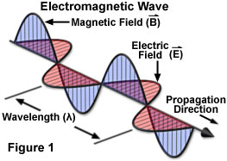
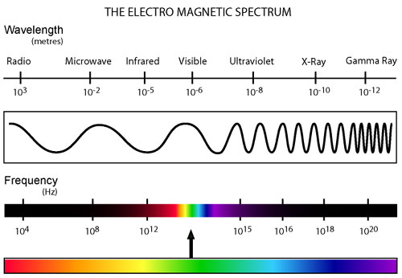
Electromagnetic Waves
Temporally changing electric and magnetic fields induce each other:
The energy of an electromagnetic wave decreases with distance squared.

Slide 25
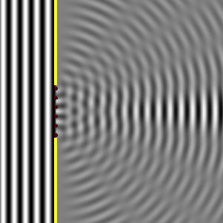
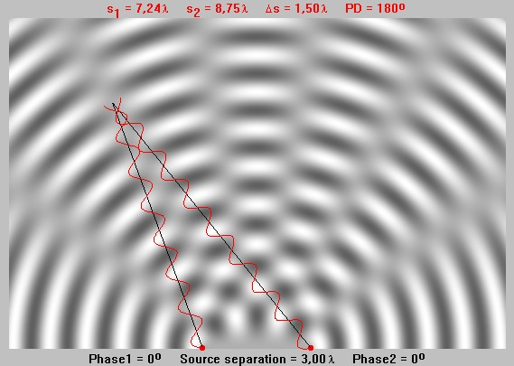
Wave Properties: Difraction and Interference

Slide 27
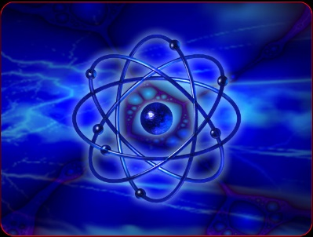
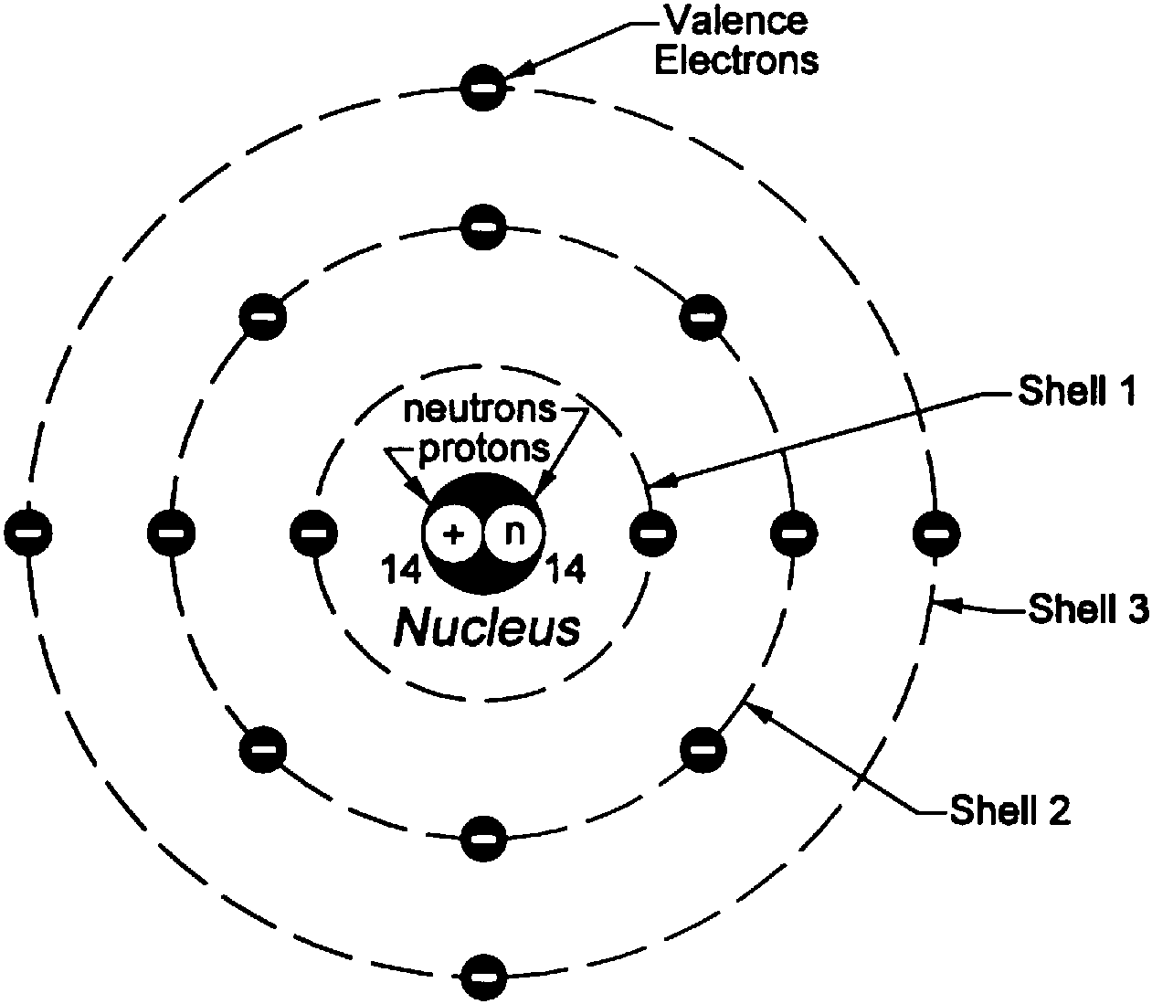
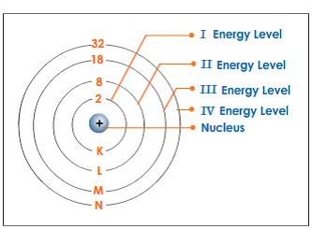
Atoms
Bohr’s Model
Electron “orbits” are associated
with different energy levels
“Atomic number”: 14

Slide 28
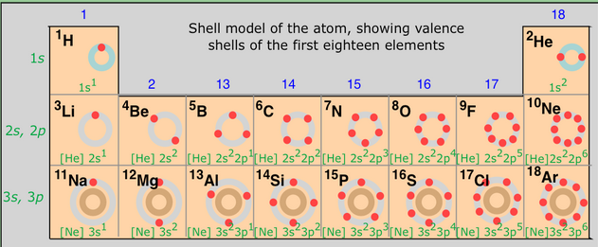
International Year of the Period Table
https://courses.lumenlearning.com/boundless-chemistry/chapter/the-history-of-the-periodic-table/

Slide 29
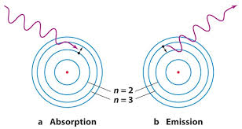
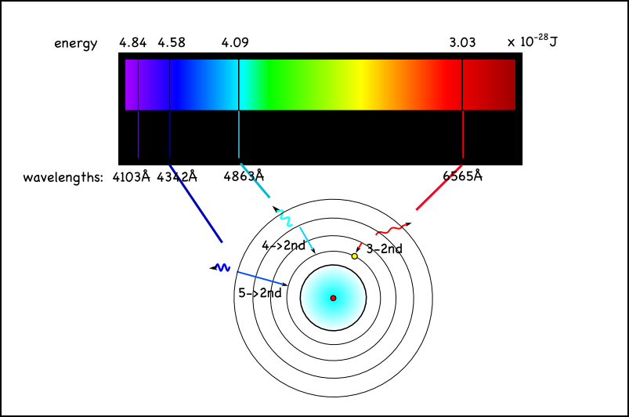
Atoms and Electromagnetic Waves
Photon
With energy E=hf
h: Planck’s constant, f: frequency
Hydrogen Absorption Spectrum
This is a bit like “potential energy” on earlier slides, but there are only distinct energetic states of the system, i.e. energy can only be absorbed or emitted in discrete “quanta”.

Slide 31
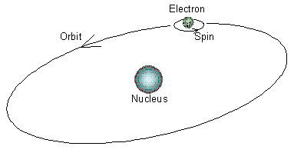
Atomic Spin
“Atomic Spin” is a purely quantum physical phenomenon.
It can be illustrated as rotation of a particle around its own axis.
In Bohr’s classical atomic model, electrons orbit around the nucleus.
A moving charge acts like a current, producing a magnetic field.
Related to magnetism.
Spin exists for many particles, including electrons and protons.
Spins can be in two states: “up” and “down”.
There are rules about how spins within one orbit are aligned to each other.

Slide 32
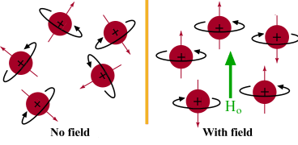
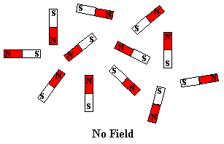
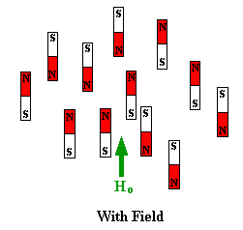
Atomic Spin
Spins align to an external magnetic field.
Principle of Nuclear Magnetic Resonance:
Align nuclear spins in a constant magnetic field.
Perturb alignment of spins using a short electro-magnetic pulse.
Measure the response over time.

Slide 33
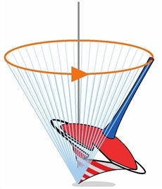
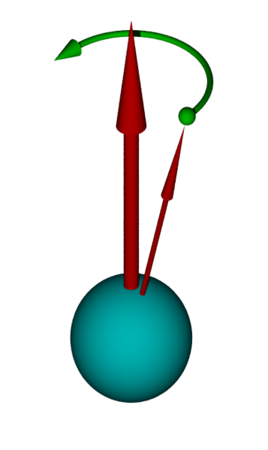
Magnetic “Resonance”
Spins can be thought of as “precessing” around the direction of the magnetic field.
Magnetic Field
Spin
http://en.wikipedia.org/wiki/Larmor_precession

Slide 34
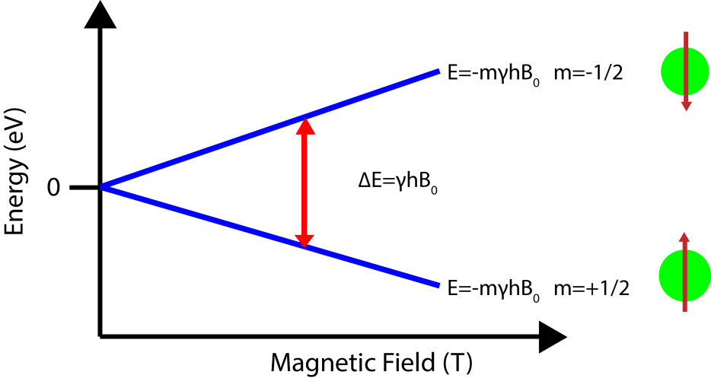
Atomic Spin
Without a magnetic field, the two spin states (“up” and “down”) have the same energy.
In a magnetic field, these states “degenerate”: parallel spins have lower energy than anti-parallel spins.
The difference between these two states depends on magnetic field strength.
= hω
ω: “Larmor frequency”
http://chemwiki.ucdavis.edu/Physical_Chemistry/Spectroscopy/Magnetic_Resonance_Spectroscopies/Nuclear_Magnetic_Resonance/Nuclear_Magnetic_Resonance_II

Slide 36
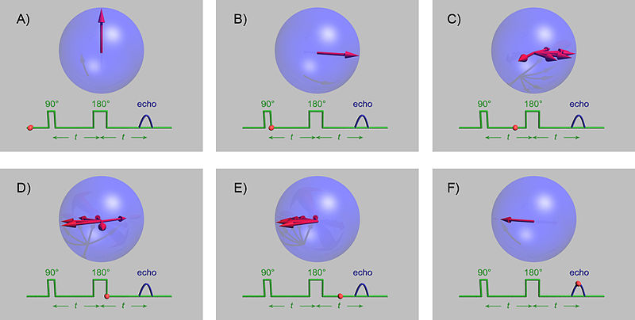
Principle of Spin Echo Imaging
Help!
(f)MRI: Radio frequency (RF) pulses change spin precession
Static magnetic field: 3T, RF frequency: 123 MHz
UHF radio: ~300 MHz, Mobile phones: ~1GHz, Microwave: ~2 GHz
http://en.wikipedia.org/wiki/Spin_echo

Slide 37
Thank you!

